Slide 1
Statistical Analysis of the Factors attributing AQI Values of Major Cities in India
Team Members:
Hrishita Bapuram (75252019004)
Maryam Amir Ahmad (75252019003)
Shraddha Kodavade (75252019011)
Mentored by :
Dr. Hemant Kulkarni

Slide 2

INTRODUCTION
Air pollution is a burgeoning environmental problem with potential for climate change.
Introspection into the various causes and mechanisms responsible for this sorry state of affairs, its impact on human health, and possible solutions to the problem is being studied in this project.

Slide 3
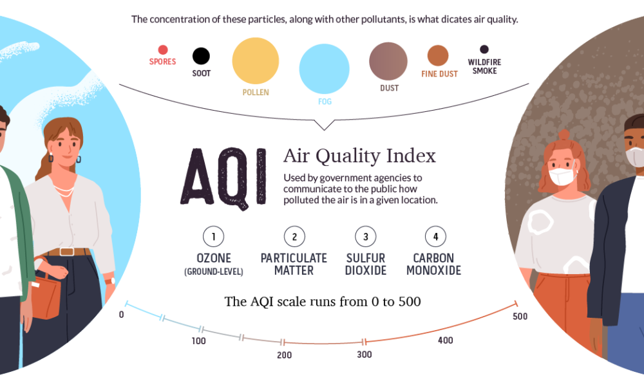
What is AQI (Air Quality Index)?
Air Quality Index (AQI) is a tool to showcase air quality status.
It transforms complex air quality data of various pollutants into a single number and color.
The Environmental Protection Agency (EPA) calculates the AQI for five major air pollutants, for which national air quality standards have been established to safeguard public health.
Ground-level ozone
Particle pollution/particulate matter (PM2.5/pm 10)
Carbon Monoxide
Sulfur dioxide
Nitrogen dioxide

Slide 4
OBJECTIVES
To test the effect of rainfall and temperature on the AQI values of the cities studied
To test the effect of Forest Area and Region (N/S) on the AQI values of the cities studied
To test the effect of Car density and Tier wise distribution of cities on the AQI values of the cities studied
To study the choice of cities for individuals before and after informing them about the respective city’s AQI levels

Slide 5
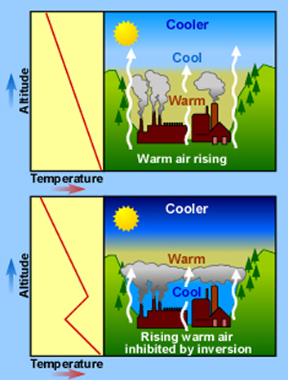
1.
To test the effect of rainfall and temperature on the AQI values of the cities studied

Slide 6
HYPOTHESES
NULL HYPOTHESES:
H₀₀ : Air Quality is not significantly affected by changes in temperature conditions
H₀₁ : Air Quality is not significantly affected by changes in rainfall
ALTERNATE HYPOTHESES:
H₁₀ : Air Quality differs significantly due to temperature
H₁₁ : Air Quality differs significantly due to rainfall
TEST USED:
Two Way ANOVA (Two Way Analysis of Variance)

Slide 7
DATA
MEAN TEMPERATURE
28-32 | A
32-35 | B
MAX RAINFALL
1-10 | Low
10-15 | Moderate
15-25 | High

Slide 8
DATA DISTRIBUTION
` | Low | Moderate | High | T_{i.} | n_{i.}
A | 104.8398 | 82.4177 | 117.7744 | 305.0319 | 3
B | 219.7202 | 180.5513 | 131.2134 | 531.4849 | 3
T_{.j} | 324.5600 | 262.9690 | 248.9878
n_{.i} | 2 | 2 | 2
G²/N | 116626.732
∑T_{i.}² / m_{i.} | 125173.5542
∑T_{.j}² / m_{.j} | 118243.4145
TSS | 13120.84094
SST | 8546.822189
SSB | 1616.682518
SSE | 2957.336237
N | 6
∑y_{ijk}² | 129747.5729
G | 836.5168
h | 3
k | 2

Slide 9
ANOVA TABLE
SOURCE OF VARIATION | SUM OF SQUARES | DF | MS | F VALUE
Treatment | 8546.822189 | 1 | 8546.822189 | 5.780081469
Block | 1616.682518 | 2 | 808.3412591 | 0.546668484
Error | 2957.336237 | 2 | 1478.668118
Total | 13120.84094 | 5
F TABULATED (α = 0.1)
8.53
9
CONCLUSION:
Since F₁ < F_{0.1}(1,2) and F₂ < F_{0.1}(2,2), we fail to reject H₀₀ and H₀₁
Therefore, the data indicates that Temperature and Rainfall do not affect Air Quality Index at 10% level of significance.

Slide 10
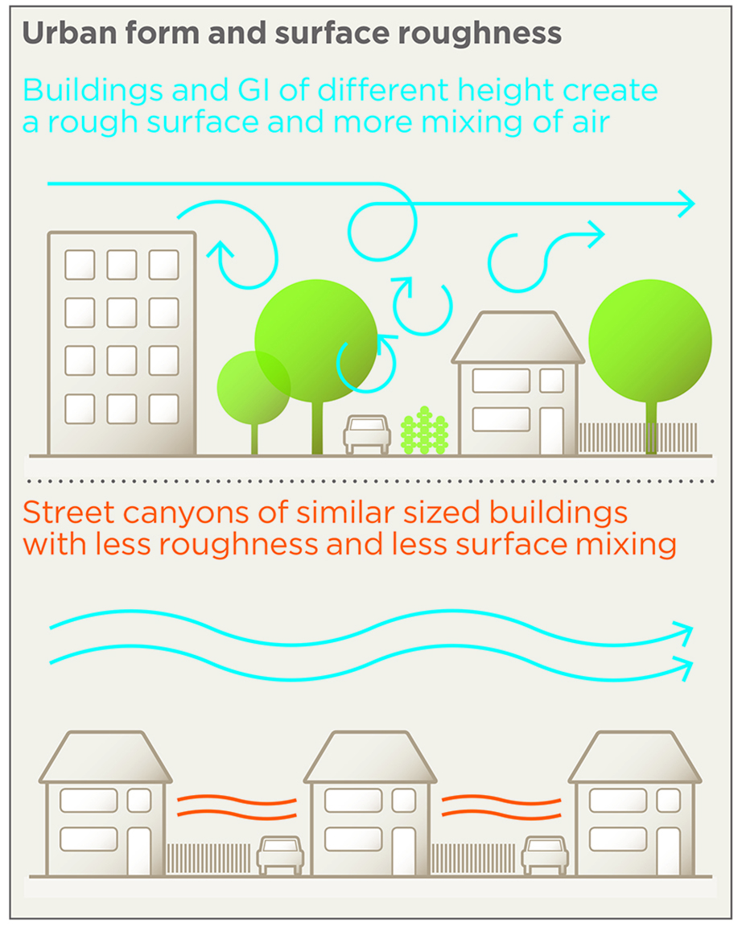
2.
To test the effect of Forest Area and Region (N/S) on the AQI values of the cities studied

Slide 11
HYPOTHESIS
NULL HYPOTHESIS:
H₀₀ : Air Quality is not significantly affected by changes in Green Area
H₀₁ : Air Quality is not significantly affected by different regional differences
ALTERNATE HYPOTHESES:
H₁₀ : Air Quality differs significantly due to proportion of green area in the city
H₁₁ : Air Quality differs significantly due to the presence of city in either North or South of India
TEST USED:
Two Way ANOVA (Two Way Analysis of Variance)

Slide 12
DATA
REGION
North
South
% OF GREEN AREA
0-10 | Low
10-25 | Moderate
>25 | High

Slide 13
DATA DISTRIBUTION
 | North | South | T_{i.} | m_{i.}
A | 198.788 | 91.581 | 290.369 | 2
B | 199.092 | 87.559 | 286.651 | 2
C | 140.512 | 93.749 | 234.261 | 2
T_{.j} | 538.392 | 272.889
m_{.i} | 3 | 3
G²/N | 109696.1435
∑T_{i.}² / m_{i.} | 123740.4486
∑T_{.j}² / m_{.j} | 811.281
TSS | 14044.3051
SST | 984.440548
SSB | 11748.6405
SSE | 1311.224052
N | 6
∑y_{ijk}² | 123740.4486
G | 811.281
h | 2
k | 3

Slide 14
ANOVA TABLE
SOURCE OF VARIATION | SUM OF SQUARES | DF | MS | F VALUE
Treatment | 984.440548 | 2 | 492.220274 | 0.750779813
Block | 11748.6405 | 1 | 11748.6405 | 17.92011134
Error | 1311.224052 | 2 | 655.612026
Total | 14044.3051 | 5
F TABULATED (α = 0.1)
9
8.53
CONCLUSION:
Since F₁ < F_{0.1}(2,2) and F₂ > F_{0.1}(1,2), we fail to reject H₀₀ and we reject H₀₁
Therefore, the data indicates that Percent of Green Area does not affect Air Quality Index and Regional differences affect AQI at 10% level of significance.

Slide 15
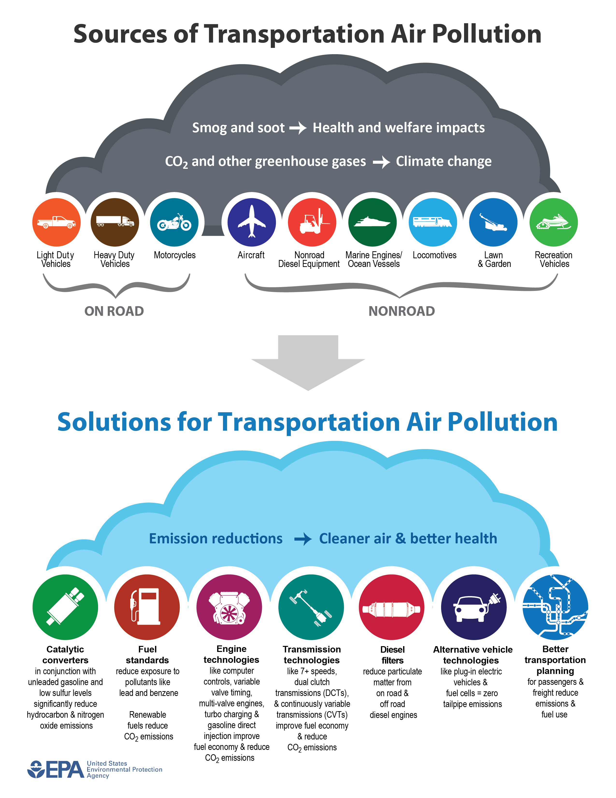
3.
To test the effect of Car density and Tier-wise distribution of cities on the AQI values of the cities studied

Slide 16
HYPOTHESIS
NULL HYPOTHESIS:
H₀₀ : Air Quality is not significantly affected by changes in Car Density
H₀₁ : Air Quality is not significantly affected by changes in population of the city
ALTERNATE HYPOTHESES:
H₁₀ : Air Quality differs significantly due to car density in the cities
H₁₁ : Air Quality differs significantly due to the population of the cities divided into tiers.
TEST USED:
Two Way ANOVA (Two Way Analysis of Variance)

Slide 17
DATA
CAR DENSITY
0-20 | A
>20 | B
TIER CATEGORY
TIER 1 | T1
TIER 2 | T2
TIER 3 | T3

Slide 18
DATA DISTRIBUTION
` | T1 | T2 | T3 | T_{i.} | n_{i.}
A | 188.92634 | 133.7808 | 147.43107 | 470.1382 | 3
B | 104.86778 | 88.12546 | 88.125461 | 281.1187 | 3
T_{.j} | 293.79413 | 221.9063 | 235.55653
n_{.i} | 2 | 2 | 2
G²/N | 94064.49131
∑T_{i.}² / m_{i.} | 100019.2198
∑T_{.j}² / m_{.j} | 95522.12702
TSS | 7791.338672
SST | 5954.728503
SSB | 1457.635708
SSE | 378.9744613
N | 6
∑y_{ijk}² | 101855.83
G | 751.256912
h | 3
k | 2

Slide 19
ANOVA TABLE
SOURCE OF VARIATION | SUM OF SQUARES | DF | MS | F VALUE
Treatment | 5954.728503 | 1 | 5954.728503 | 31.425487
Block | 1457.635708 | 2 | 728.8178538 | 3.846263684
Error | 378.9744613 | 2 | 189.4872306
Total | 7791.338672 | 5
F TABULATED (α = 0.1)
8.53
9
CONCLUSION:
Since F₁ > F_{0.1}(1,2) and F₂ < F_{0.1}(2,2), we reject H₀₀ and we fail to reject H₀₁
Therefore, it indicates that Car Density affects Air Quality Index and Tier-wise differences do not affect AQI at 10% level of significance.

Slide 20
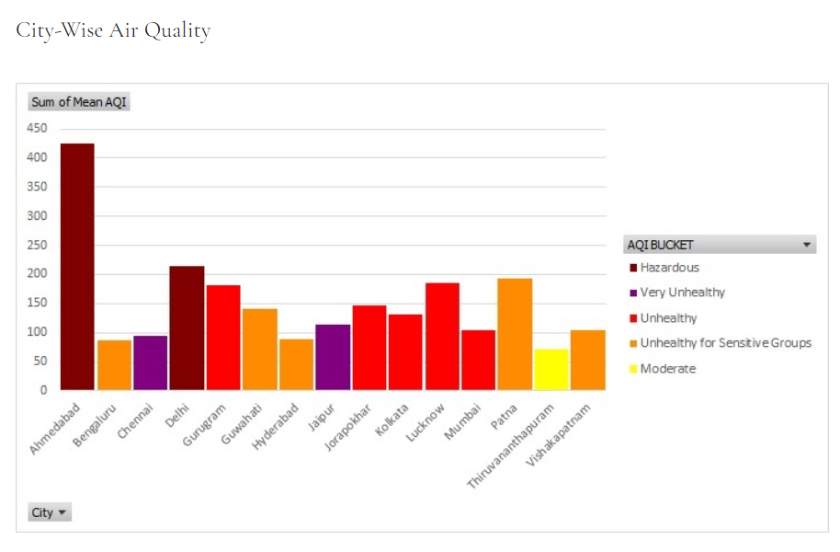
4.
To study the choice of cities for individuals before and after informing them about the respective city’s AQI levels

Slide 21
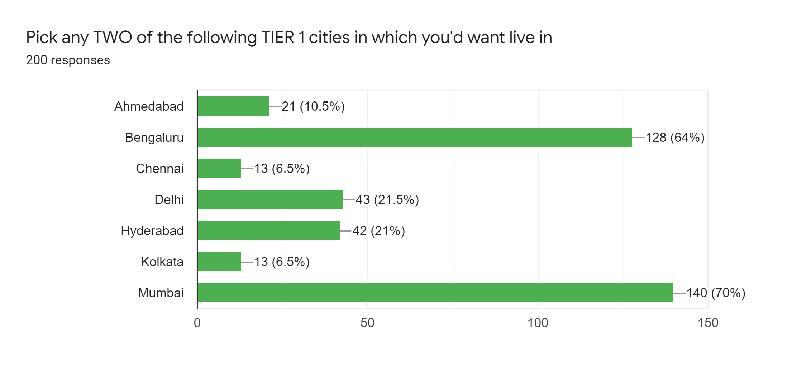
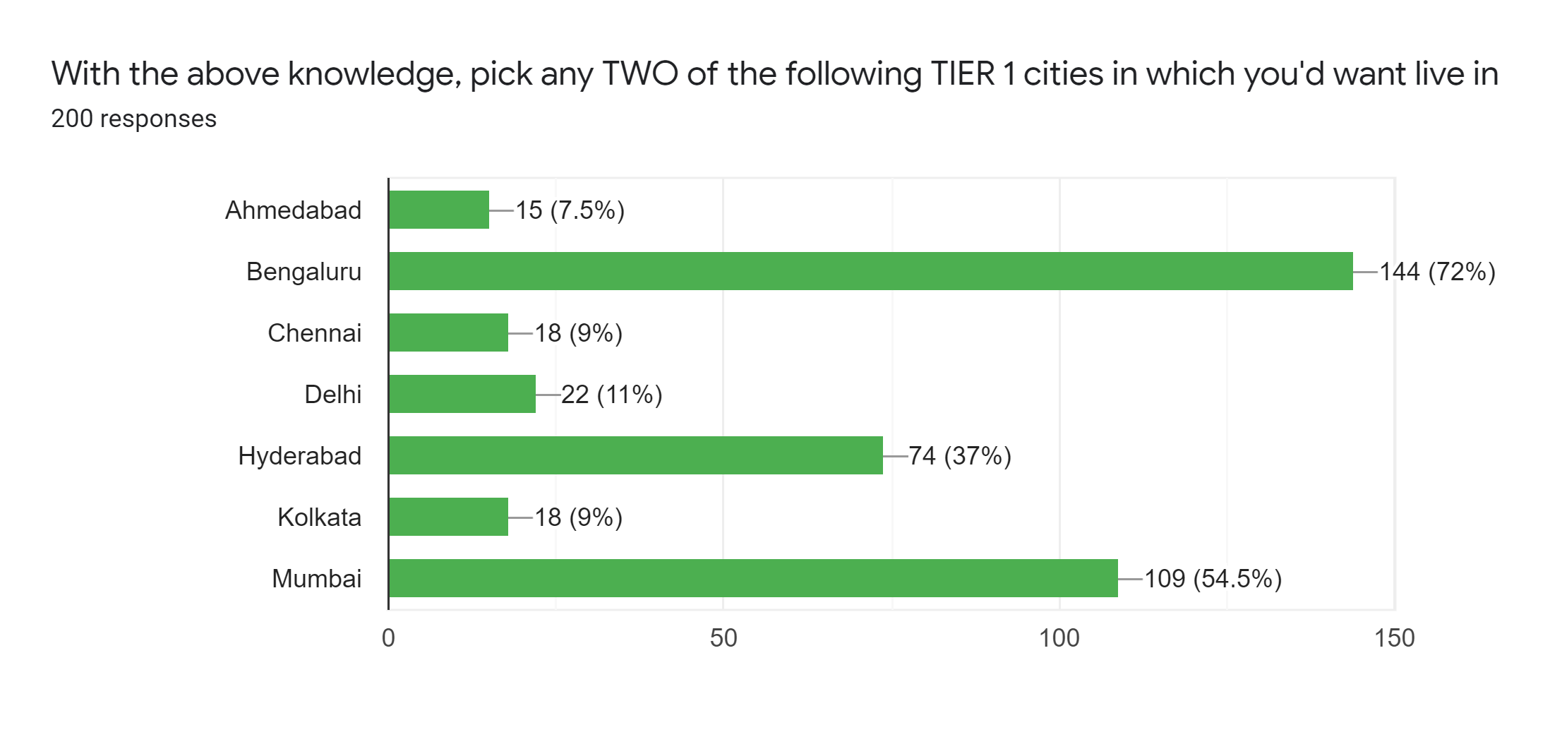
TIER 1 CITIES CHOICE
WITHOUT AQI KNOWLEDGE WITH AQI KNOWLEDGE

Slide 22
TIER 1 CITIES CHOICE
Rank Tier 1 | City | City | Mean AQI | Category
1 | Bengaluru | Bengaluru | 87.55941 | G
2 | Hyderabad | Hyderabad | 88.12546 | G
3 | Chennai | Chennai | 95.03663 | G
4 | Mumbai | Mumbai | 104.8678 | G
5 | Kolkata | Kolkata | 131.2134 | B
6 | Delhi | Delhi | 213.6716 | B
7 | Ahmedabad | Ahmedabad | 424.9242 | B
 |  | AFTER
 |  | GOOD | BAD | TOTAL
BEFORE | GOOD | 2 | 4 | 6
 | BAD | 193 | 1 | 194
 | TOTAL | 195 | 5 | 200

Slide 23
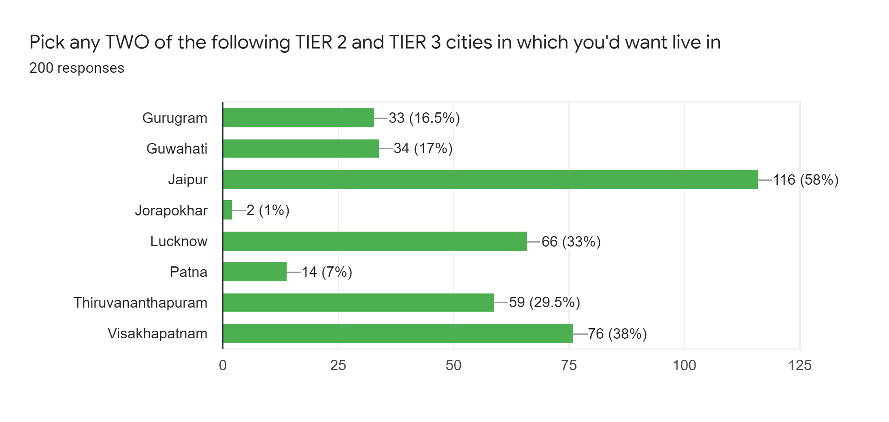
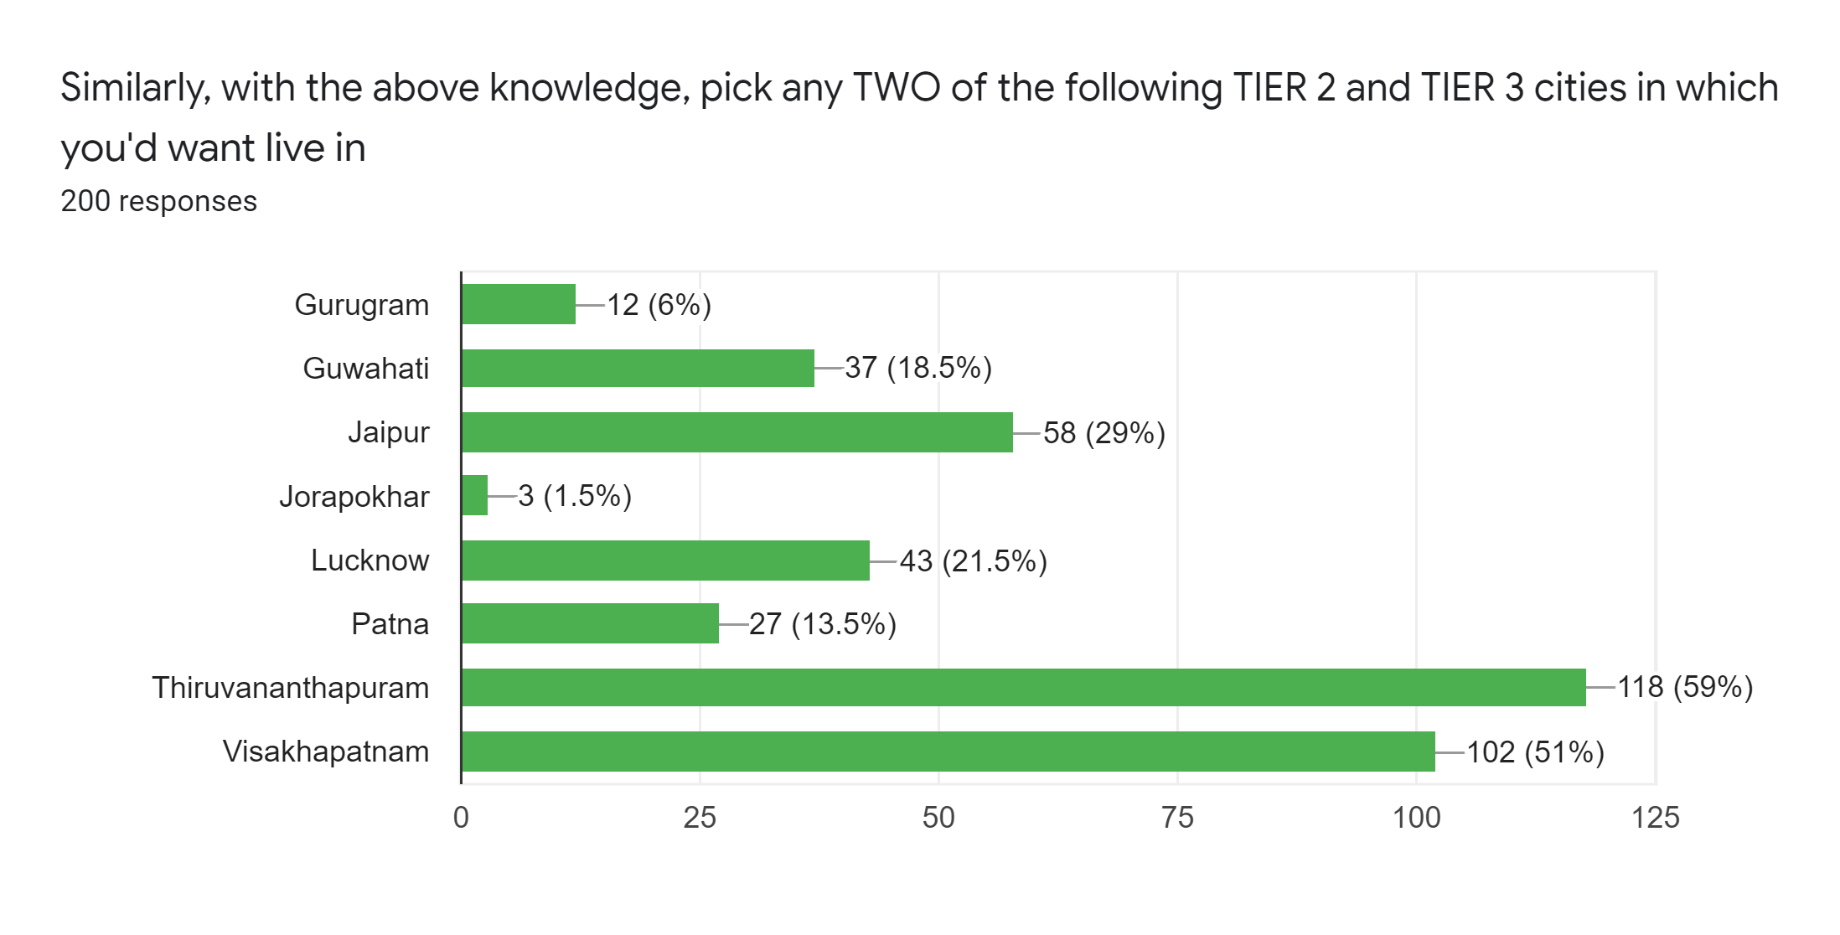
TIER 2 & 3 CITIES CHOICE
WITHOUT AQI KNOWLEDGE WITH AQI KNOWLEDGE

Slide 24
TIER 2 & 3 CITIES CHOICE
Rank Tier 2/3 | City | City | Mean AQI | Category
1 | Thiruvananthapuram | Thiruvananthapuram | 71.56814 | G
2 | Vishakapatnam | Vishakapatnam | 104.8119 | G
3 | Jaipur | Jaipur | 114.2921 | G
4 | Guwahati | Guwahati | 140.5122 | B
5 | Jorapokhar | Jorapokhar | 147.4311 | B
6 | Gurugram | Gurugram | 181.1529 | B
7 | Lucknow | Lucknow | 184.513 | B
8 | Patna | Patna | 193.7189 | B
 |  | AFTER
 |  | GOOD | BAD | TOTAL
BEFORE | GOOD | 1 | 4 | 5
 | BAD | 191 | 4 | 195
 | TOTAL | 192 | 8 | 200

Slide 25
LIMITATIONS
The study was not inclusive of all of the states in India. (We chose just 15 cities because of unavailability of data for other cities and hence the data was not representative of India.
Data was just restricted till Jun 2020.​
Car registration was considered constant due to the lack of unavailability of data.
Only a limited number of factors were considered.​

Slide 26
FUTURE SCOPE

Slide 27
Studying the relationship between other contributors to the AQI , i.e. Wind Speed Direction, Precipitation rate, Sun Radiations, Water Body distribution etc.
Use dashboard visualizations like scatter plots to intuitively study of dependency of two or more variables and hence establish the interdependence among them. (Can hence be mathematically verified).
To further contribute in the research dimension wherein results derived can be used to study economic indicators like QOL (Quality of Life) – HDI, Pollution Levels and others that contributes to further navigate the living index of a city and the healthcare of its territorial citizens.
Statistically deduce if the formulations and policies have worked, and hence reason the deviations, if found.
Many other factors like odd-even rule, other festivals and occasions (Holi, Diwali, New Year, etc), seasonal comparison (Summer vs Winter), Global Warming, Trading Peaks, proximity to airports and railway stations etc. can be examined.

Slide 28
REFERENCES
* data.gov.in – Open Government Data (OGD) Platform, India * moef.gov.in – Ministry of Environment, Forest and Climate Change * cpcb.nic.in – Central Pollution Control Board of India * airnow.gov – Home of U.S. Air Quality Index * scied.ucar.edu – UCAR Center for Science Education * nrdc.org – National Resources Defence Council * the-ies.org – The Institution of Environmental Sciences

Slide 29
ACKNOWLEDGMENTS
We would like to acknowledge and express our gratitude to our Mentor for this project, Dr. Hemant Kulkarni for helping us structure, format and understand the concepts and techniques employed in the project.
We would like to thank NMIMS deemed to be university, Navi Mumbai for introducing us to the opportunity to work together and for providing us with all the necessary resources that were essential for carrying out this research.
We acknowledge the contributions of our amazing respondents who took out the time to fill our survey so that we could get the primary data and helped us get the responses that were generated.
Finally, we would like to express our gratitude to the various sources from which we extracted the data for this project, without which none of this would truly be possible.

Slide 30
OUR TEAM
HRISHITA BAPURAM
MARYAM AMIR AHMAD
SHRADDHA KODAVADE

Slide 31
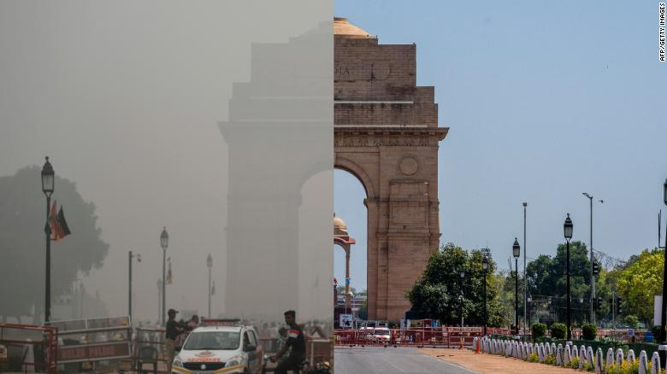
“Just breathing can be such a luxury sometimes”
~ Walter Kirn

Slide 32
Thanks!
]]

